Slide 1
Capstone Project NETFLIX MOVIES AND TV SHOWS CLUSTERING
Team members
Laveti Syam Sagar
Sohail Mohammad
Bisetty Kodanda Nagesh

Slide 2
Problem Description
This dataset consists of tv shows and movies available on Netflix as of 2019. The dataset is collected from Flexible which is a third-party Netflix search engine.
In 2018, they released an interesting report which shows that the number of TV shows on Netflix has nearly tripled since 2010. The streaming service’s number of movies has decreased by more than 2,000 titles since 2010, while it’s number of TV shows has nearly tripled. It will be interesting to explore what all other insights can be obtained from the same dataset.
Integrating this dataset with other external datasets such as IMDB ratings and rotten tomatoes can also provide many interesting findings.

Slide 3
Problem Description
In this project you are required to do
1. Exploratory Data Analysis
2. Understanding what type of content is available in different countries
3. Is Netflix increasingly focusing on TV rather than movies in recent years?
4. Clustering similar content by matching text-based features
Based on the attributes related to the Tv shows or movies we'll be executing diﬀerent clustering algorithms which come under the unsupervised Machine learning category.

Slide 4
Data Description
The dataset including over 7787 records and 12 attributes.
show_id: Unique ID for every Movie/ Tv Show
type: Identifier - A Movie or TV Show
title: Title of the Movie / Tv Show
director: Director of the Movie
cast: Actors involved in the movie/show
country: Country where the movie/show was produced
date_added: Date it was added on Netflix
release_year: Actual Release year of the movie/show
rating: TV Rating of the movie/show
duration: Total Duration - in minutes or number of seasons
listed_in: Generes
description: The Summary description

Slide 5
Data Cleaning
Earlier to EDA, cleaning the data is fundamental since it'll get rid of any ambiguous data that can have an affect on the results.
executive, cast, nation, date_added and rating columns have missing or null values. We replaced all the null values of the columns with ‘Not Known’.
we removed the show id column because it doesn't offer any useful information.
show_id 0
type 0
title 0
director 2389
cast 718
country 507
date_added 10 release_year 0
rating 7
duration 0
listed_in 0
Description 0

Slide 6
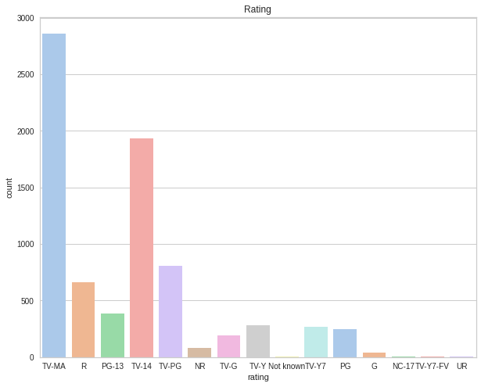
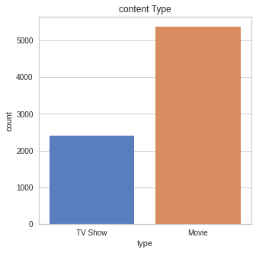
Exploratory Data Analysis

Slide 7
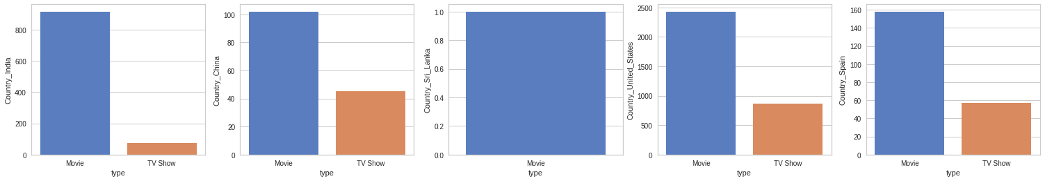
BAR PLOTS FOR COUNTRIES BASED
Bar plots for various countries based on the type of content.
showing the bar plots for Sri Lanka, China, India , United States and Spain For other nations, similar bar plots were also created.

Slide 8
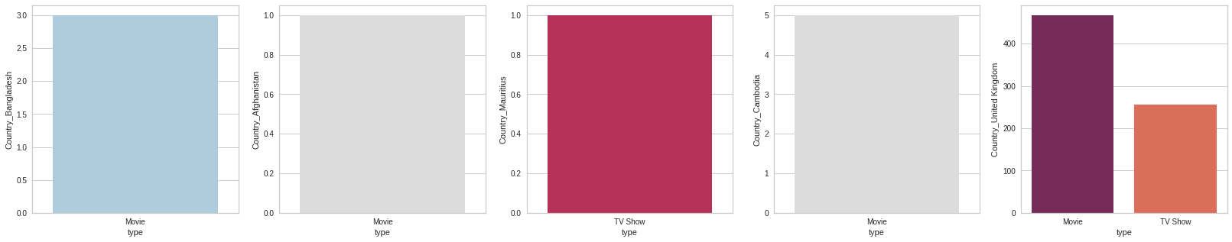
BAR PLOTS FOR COUNTRIES BASED
Country:- Bangladesh, Afghanistan, Mauritius, Cambodia, United Kingdom

Slide 9
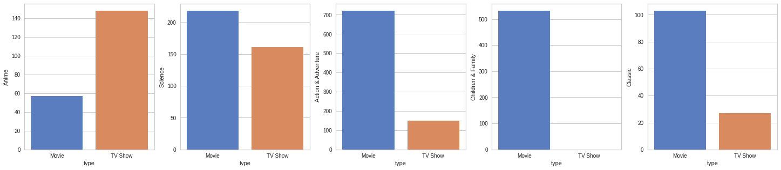
BAR PLOTS FOR COUNTRIES BASED
Visualization of the genres and respective content type count

Slide 10
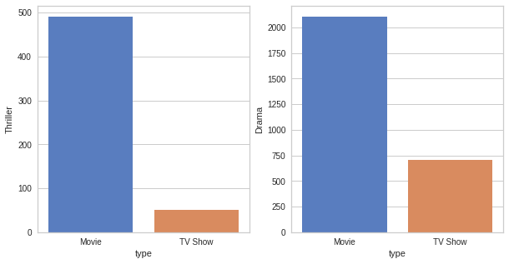
BAR PLOTS FOR COUNTRIES BASED
Choosing to display bar plots for three types of anime, science fiction, action, and adventure here. Similar bar plots were created for all genres.

Slide 11
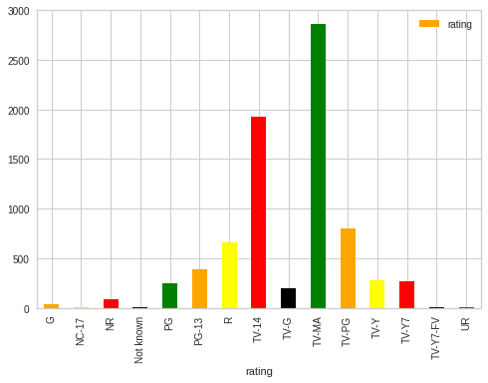
Movies count for Different Ratings.
Bar plot to check the shows or movies count for different ratings.

Slide 12
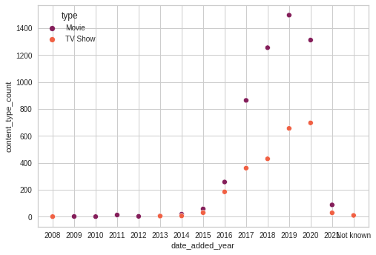
Content to Scatter plot as per year
Scatter plot to check the content type for different years when the data was added to Netflix

Slide 13
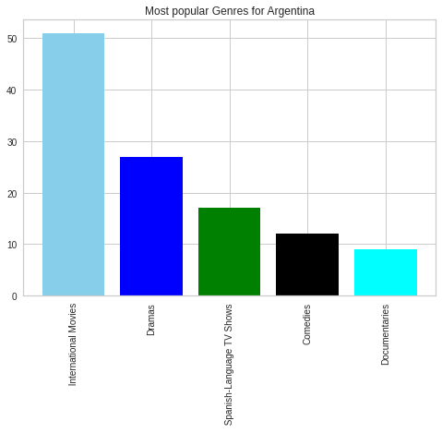
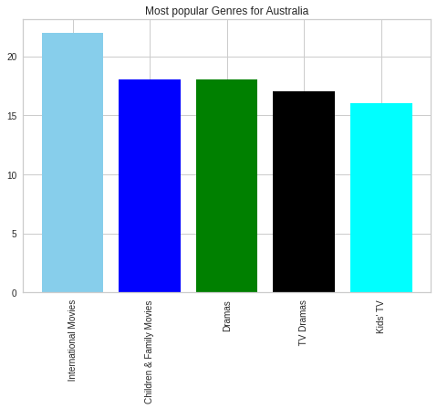
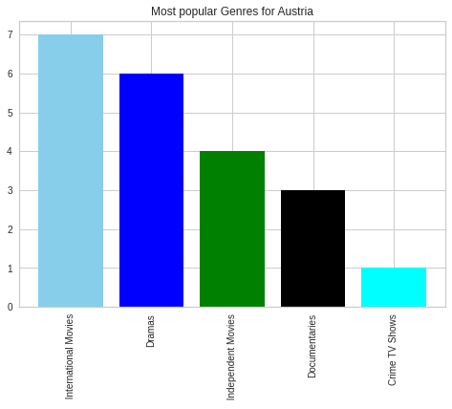
Most popular Genres in each Country.
Bar Plots represent the most popular genres in each country.

Slide 14
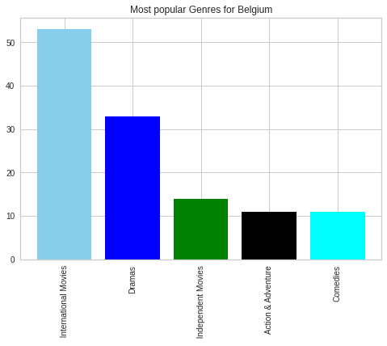
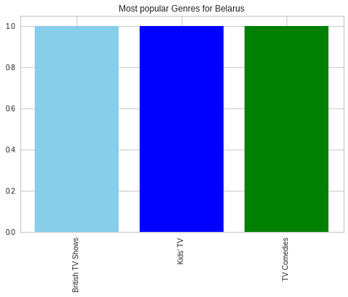
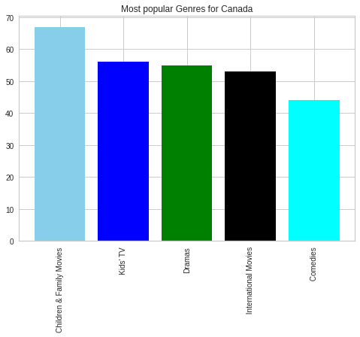
Most popular Genres in each Country.
Bar Plots represent the most popular genres in each country.

Slide 15
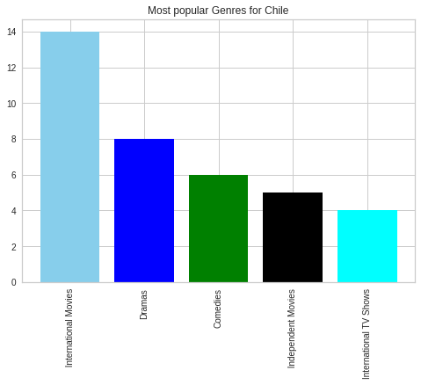
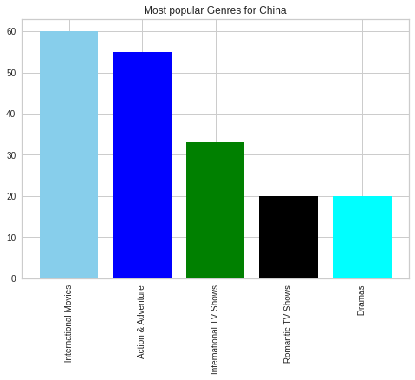
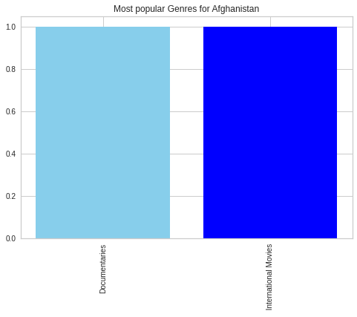
Most popular Genres in each Country.
Bar Plots represent the most popular genres in each country.

Slide 16
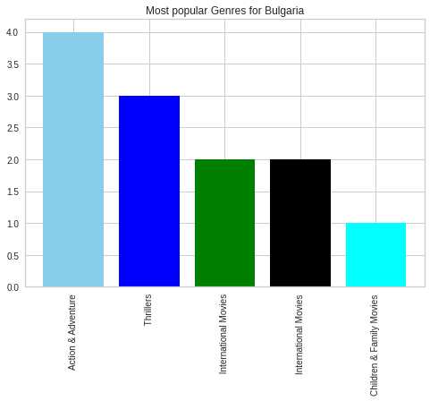
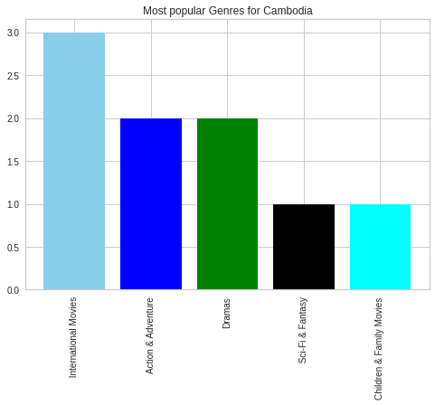
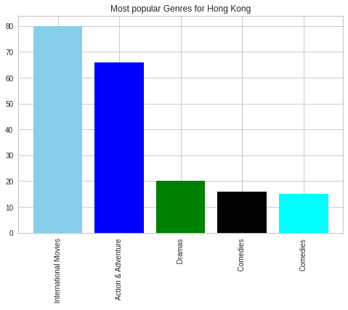
Most popular Genres in each Country.
Bar Plots represent the most popular genres in each country.

Slide 17
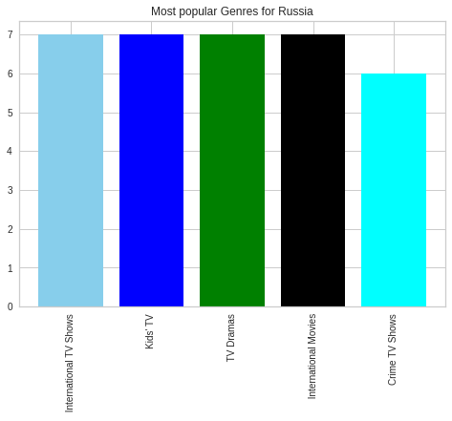
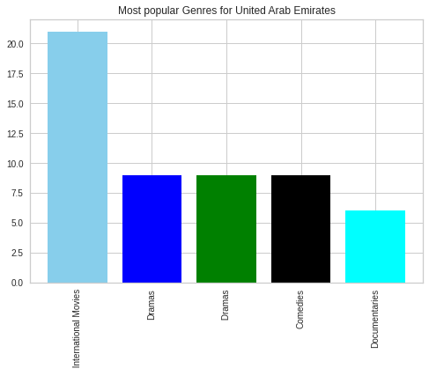
Most popular Genres in each Country.
Bar Plots represent the most popular genres in each country.

Slide 18
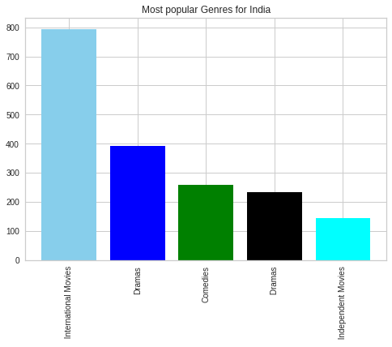
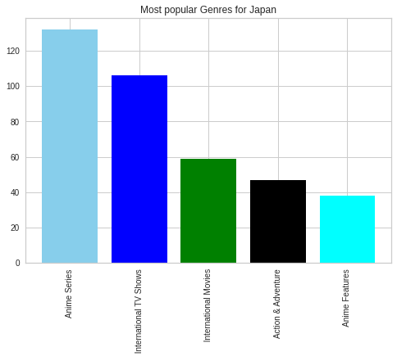
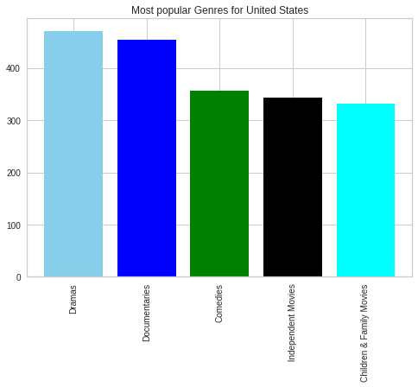
Most popular Genres in each Country.
Bar Plots represent the most popular genres in each country.

Slide 19
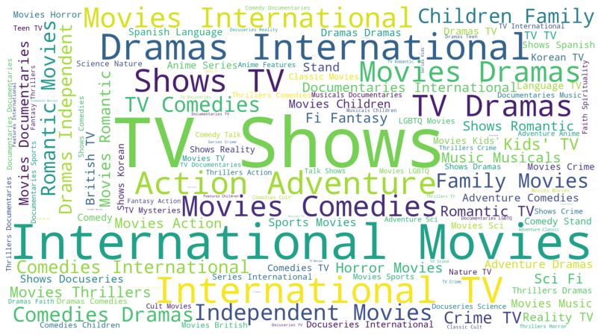
WORD CLOUD
Word Cloud to check the frequency of the genre of the Netflix content

Slide 20
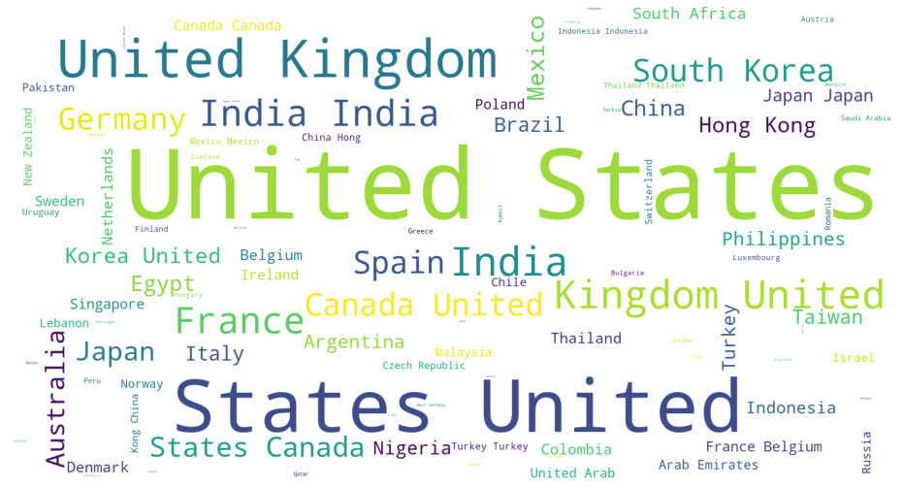
WORD CLOUD
Word cloud for the Netflix content for check most common countries.

Slide 21
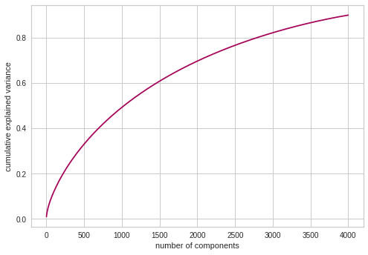
Data transformation
TF-IDF: Term Frequency, Inverse Document Frequency. It indicates the significance/relevance of a word in a corpus. Term Frequency represents the number of instances of a given word and inverse document frequency tests how relevant the word is.
PCA: PCA is a dimensionality reduction technique. In this principal components are computed, and a lot of information is also retained. The graph shows the explained variance value for the different number of PCA components. n_components 4000 was chosen in this project.
Explained variance for different number of
components

Slide 22
Implementation of Clustering Algorithm
Textual data were combined and converted into numerical data using TF-IDF. Applied PCA to perform dimensionality reduction. Data were converted to 4000-dimensional data. K-Means is used in this project.
Some Clustering algorithms:
K-Means Clustering
Gaussian Clustering
Agglomerative clustering

Slide 23
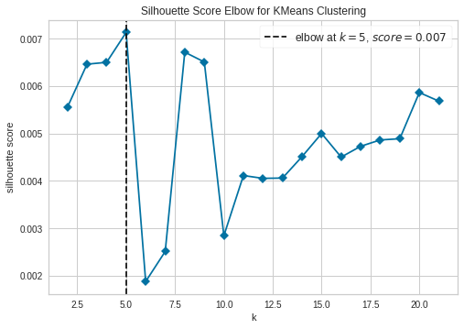
K-Means Clustering
The maximum score for the silhouette and elbow are both at cluster number 5, which was regarded as the ideal number of clusters.

Slide 24
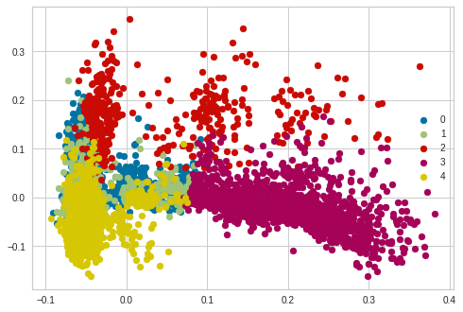
K-Means Clustering
Plotting the Results

Slide 25
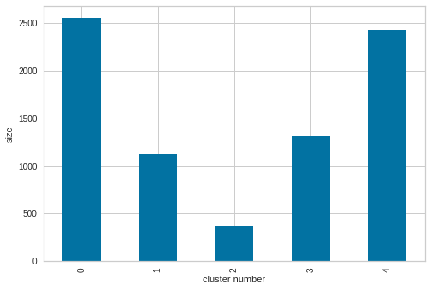
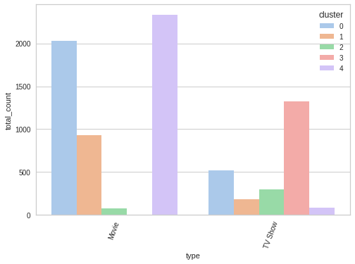
Cluster Analysis
Size of Clusters
Cluster-wise content Type

Slide 26
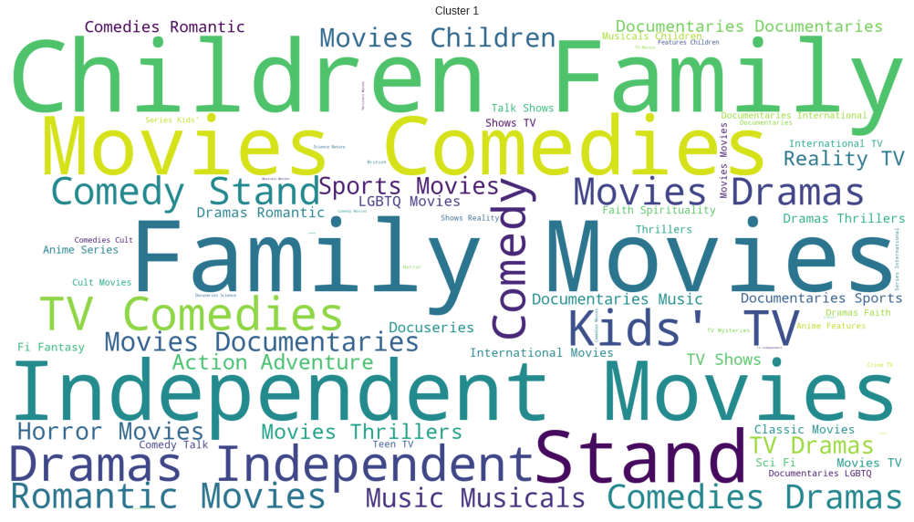
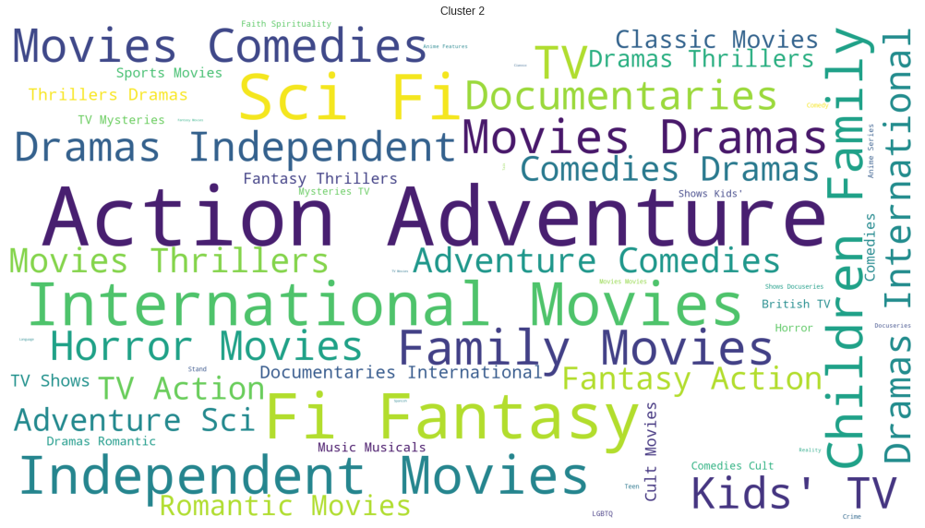
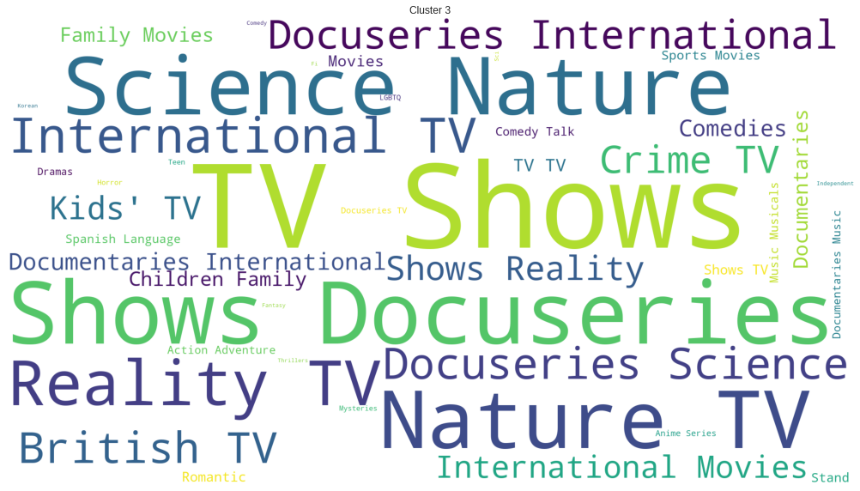
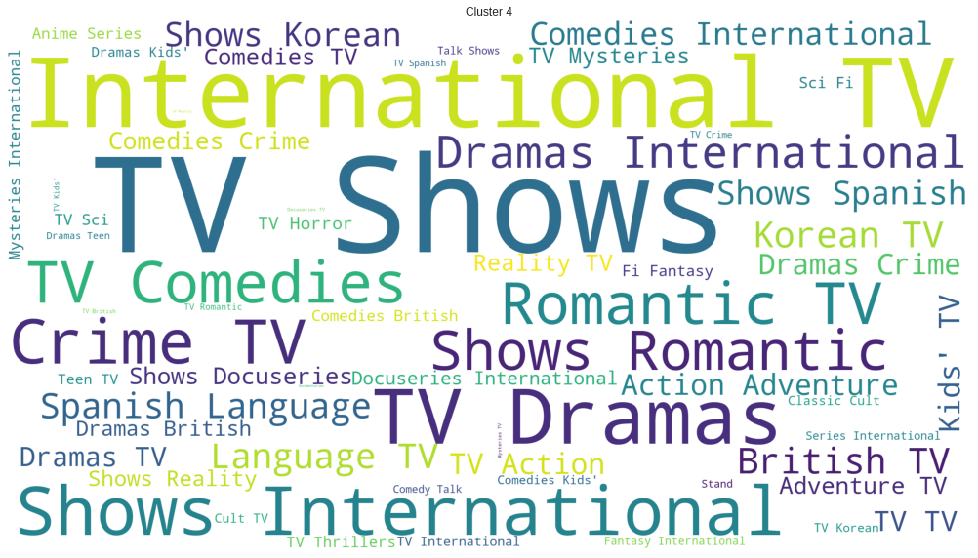
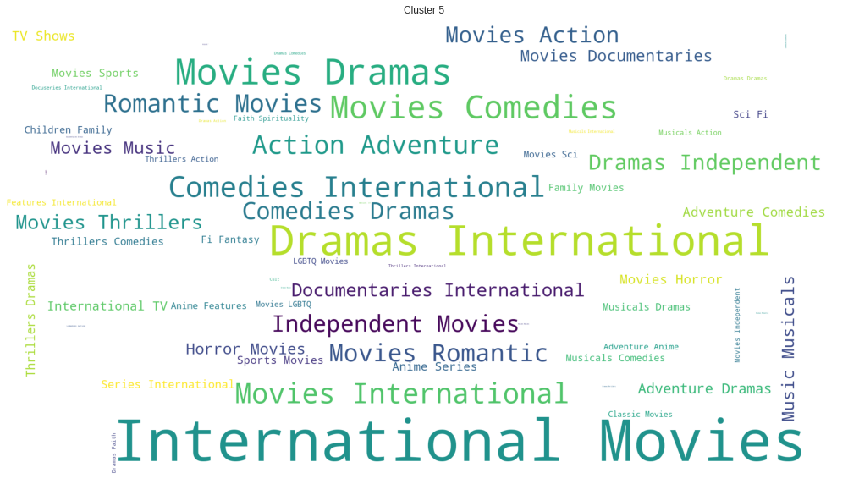
Cluster Analysis
Cluster wise genres distribution via world cloud

Slide 27
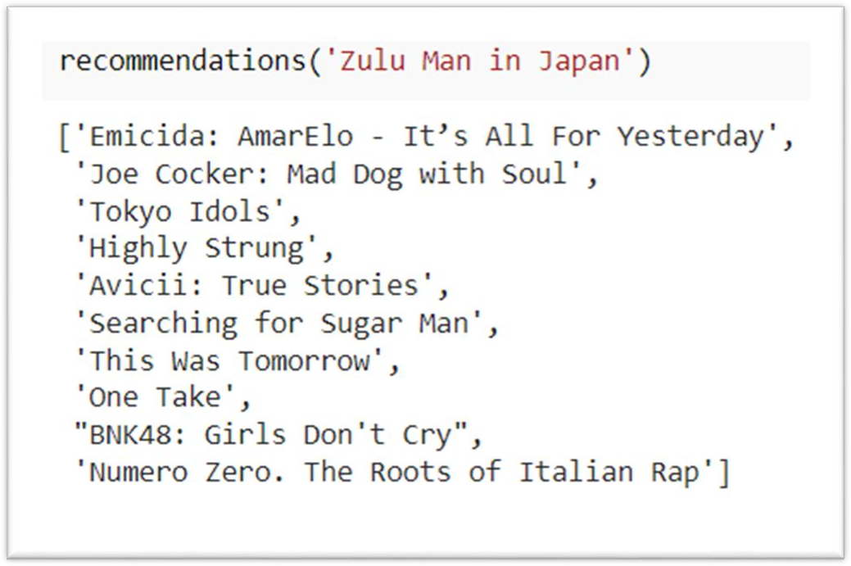
Content Based Recommender System
Count Vectorizer: Textual data was transformed using Count Vectorizer.
Cosine Similarity: Cosine similarity was used to locate related movies/TV series.

Slide 28
Conclusion
1. EDA was used to examine the data.
2. Textual data were converted using stemming. Data cleansing for the textual data was done.
3. Textual data were transformed using TF-IDF.
4. Dimensionality was reduced by using PCA. The explained variance vs. components graph was
used to choose the components.
5. Clustering using K-means was used.
6. Utilizing the elbow curve graph and the Outline score, the ideal number of clusters was
discovered.
7. The characteristics of a few clusters were compared.
8. Utilizing a check vectorizer, a content-based proposal system was developed. For any movie title entered, it proposes 10 other movies or TV shows that are similar.

Slide 29
THANK YOU

